Slide 1
DMS data analysis
Kai Hu
12/05/2019

Slide 2
Agenda
Deep Mutational Scanning (DMS) strategy
DMS analysis pipeline
Pipeline implementation
Setup
GUI mode
Command line mode
Examples

Slide 3
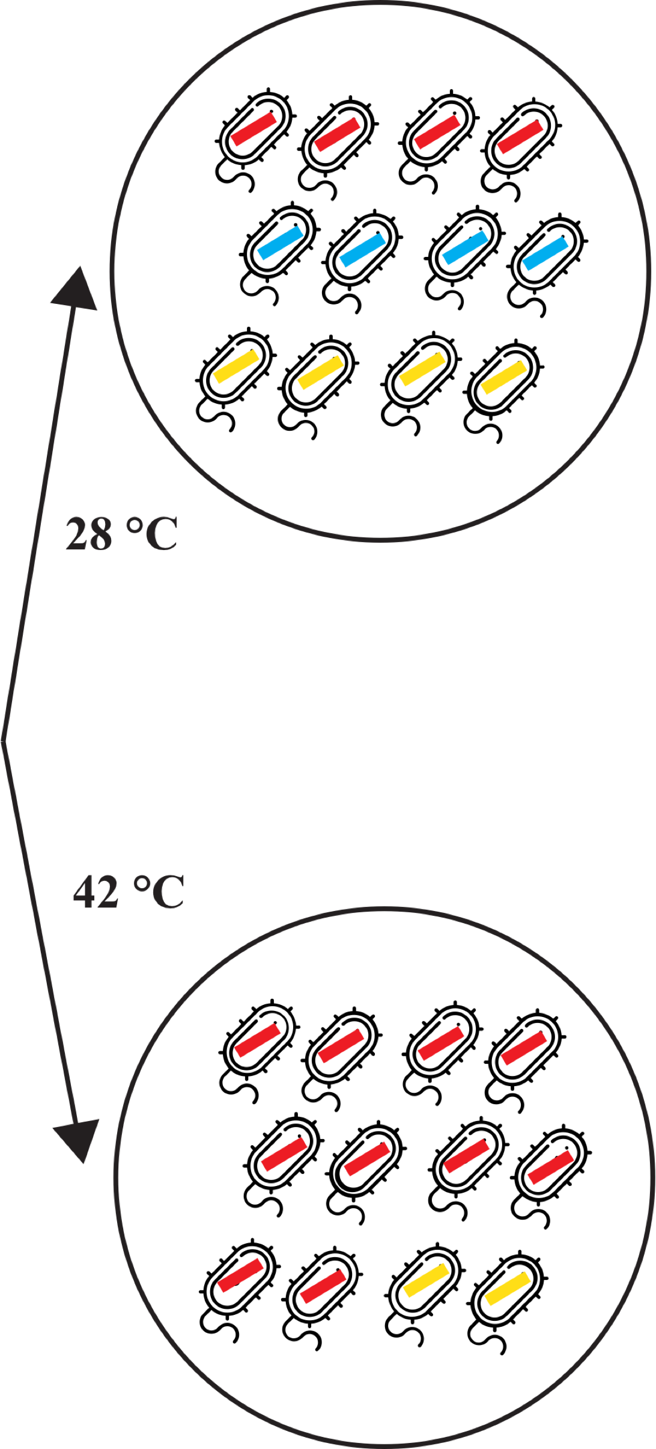
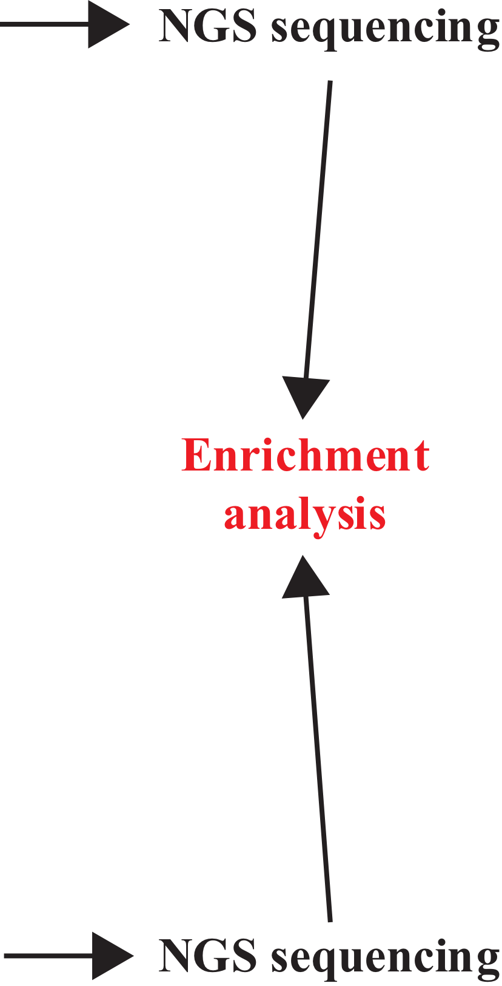
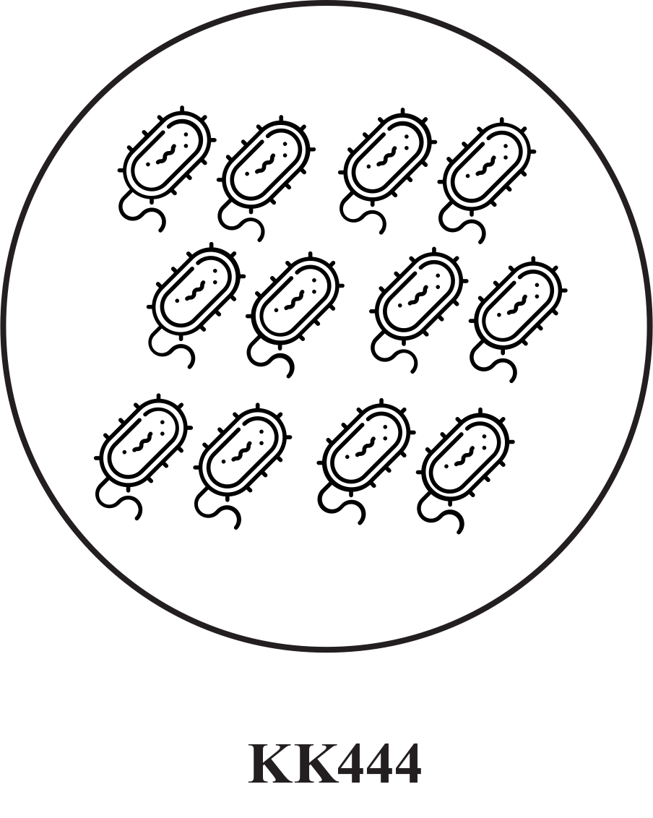
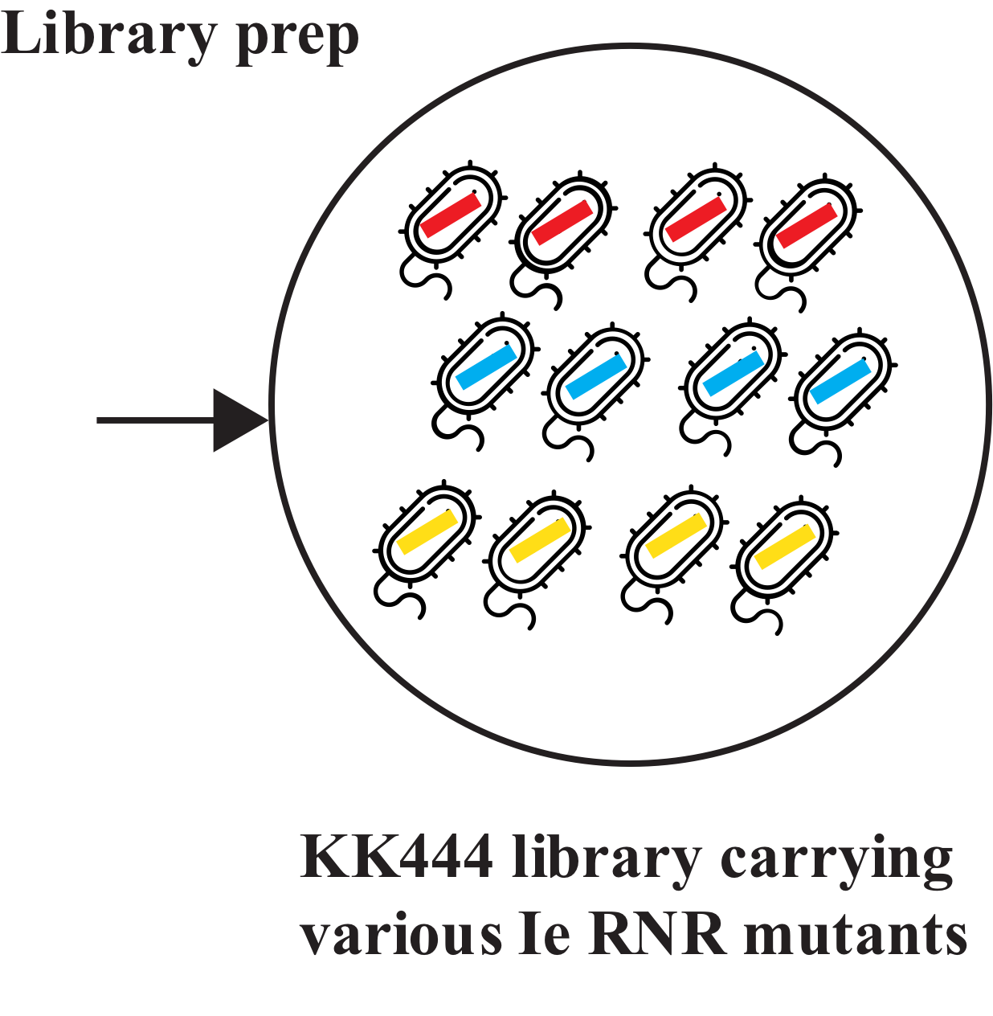
DMS strategy
Can be leveraged to examine the fitness landscape of mutants.

Slide 4
DMS analysis pipeline (with NGS data)
enrichment scores with Enrich2 (also contains count data)
raw bam files
data_sra
first_mapper
second_mapper
enrich_output
plot_output
raw NGS fastq
filtered bam files
(remove queries with INDELs/unexpected mutations)
Key intermediate files are shown above.

Slide 5
DMS analysis pipeline setup
Tested on MacOS 10.15.1 (Catalina) and 10.13.
0. Make sure Anaconda3 is installed:
https://www.anaconda.com/distribution/
For best compatibility, use conda 4.7.12, which can be found here:
https://drive.google.com/open?id=1JyetMHr8USOZCj_IeLh1fmupu1DnsRwt
1. Download the GitHub repo:
https://github.com/hukai916/DMS_project_v_2.5/archive/master.zip
2. Unzip the zip file
3. Navigate to the ‘script’ folder using Terminal
Under ‘script’ folder, do:
bash setup.sh

Slide 6
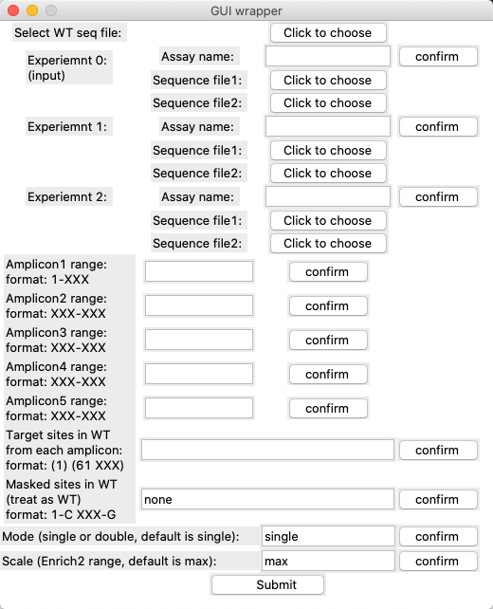
DMS analysis -- GUI mode
Under ‘script’ folder, do:
bash gui.sh
2. Fill in the required information and click ‘submit’ button
(Don’t put ‘-’ into ‘Assay name’)
Note that, if there are sites outside the target regions that have been intentionally engineered to harbor mutations for primer design purposes, please mask them by filling ‘Masked sites in WT’ so that they won‘t be treated as unexpected mutations and the corresponding reads won’t be filtered out.

Slide 7
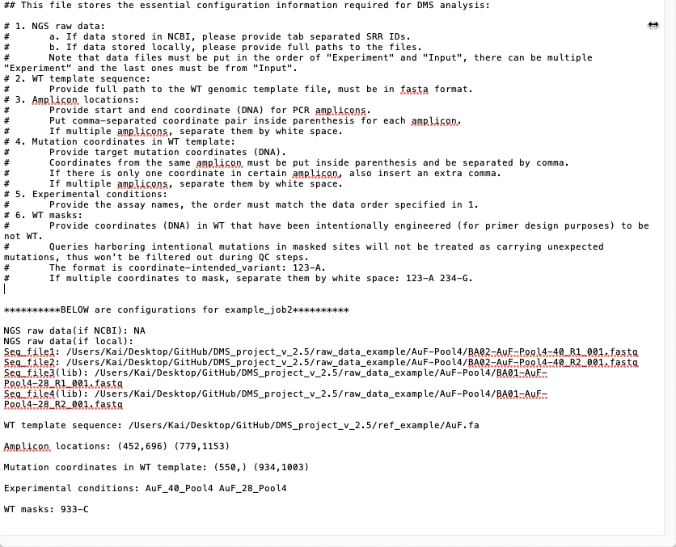
DMS analysis -- Command line mode
Under ‘script’ folder, do:
bash wrapper.sh -c=../config_file.txt
(Put an extra comma if only one target site in certain amplicon.
An example configuration file.

Slide 8
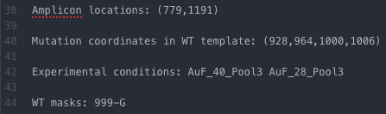
DMS analysis -- Example1 (AuF_pool3)
4 target mutation sites on one amplicon:
Result (aa-based plot):
Red: enriched
Blue: depleted
Dark Blue: total depletion
Gray: not enough data

Slide 9
DMS analysis -- Example1 (AuF_pool3)
Red: enriched
Blue: depleted
Dark Blue: total depletion
Gray: not enough data
If plot looks wrong with certain site, double check read counts:
For example, for site 334, you can find count file here:
enrich_output/aa_tsv/AuF_40_Pool3_1000_1002_GAT.tsv
https://github.com/hukai916/DMS_project_v_2.5/blob/master/result_example/job1/enrich2_output/aa_tsv/AuF_40_Pool3_1000_1002_GAT.tsv

Slide 10
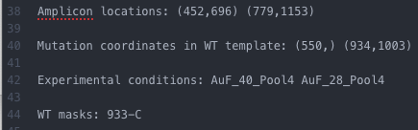
DMS analysis -- Example2 (AuF_pool4)
4 target mutation sites on two amplicons:
Result (aa-based plot):
Red: enriched
Blue: depleted
Dark Blue: total depletion
Gray: not enough data

Slide 11
Other features
Change color bar scale by setting -s flag or ‘Scale’ in GUI mode:
bash wrapper.sh -c=../config_example_job1.txt -s=1
Set to default
Set to 1
Double mutation mode by setting -m flag or ‘Mode’ in GUI mode:
bash wrapper.sh -c=../config_example_job1.txt -m=double

Slide 12
Clean intermediate files
Save your desired plots somewhere else before cleaning up all intermediate files using:
bash folder_clean.sh
(this will delete all job-specific folders under the master directory making a clean space for next job)

Slide 13
Hands-on session
For more info, go to:
https://github.com/hukai916/DMS_project_v_2.5/blob/master/READEME.md
Questions and bugs send to Kai: hukai916@gmail.com

